Slide 1
M4

Slide 2

Levels of cause of a disease
What causes disease?

Slide 3
Levels of cause of a disease
Though infectious diseases are caused by pathogens, there are various other factors which contribute to a disease.
Diseases generally have more than one cause.
There is an immediate cause and other contributory causes.
Let us understand this with an example.
Disease causing germs

Slide 4
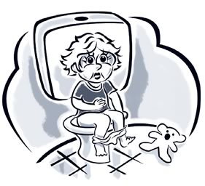
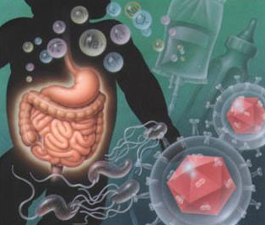
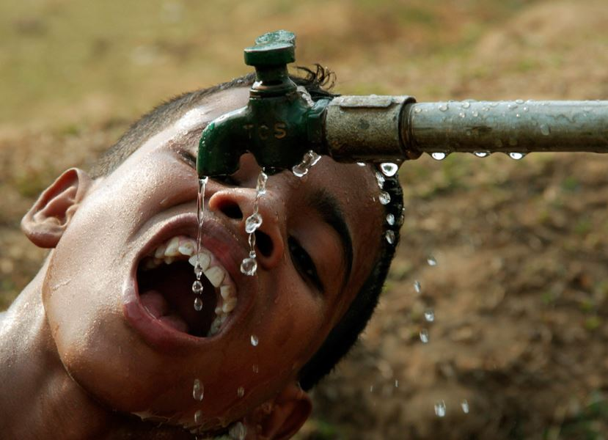
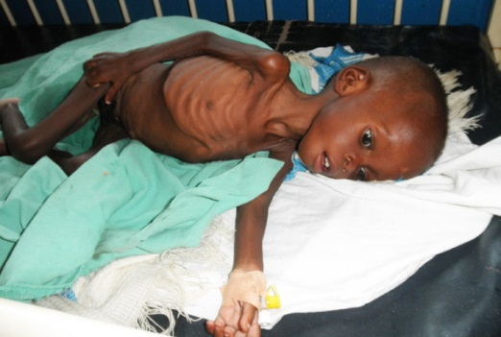
Levels of cause of a disease
If there is a baby suffering from loose motions, we can say that the cause of the loose motions is an infection with a virus.
So the immediate cause of a disease is a virus.
Through unclean drinking water.
But many babies must have had this unclean drinking water.
So, why is it that one baby developed loose motions when the other babies did not?
One reason might be that this baby is not healthy.
As a result, it might be more likely to have disease when exposed to risk, whereas healthier babies would not.
Where did the virus come from ?

